Slide 1
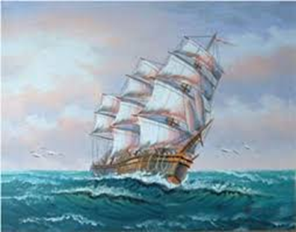
WE’RE NOT AFRAID TO DIE …. IF WE CAN ALL BE TOGETHER
By
GORDON COOK
&
ALAN EAST
MODULE-2 of 2

Slide 2
FIGHT FOR SURVIVAL
JANUARY -3
They were able to control the water level to such an extent that they took rest for 2 hours by taking turns.

Slide 3
THE OTHER CONCERN
They still had a tremendous leak somewhere below the waterline.
The wave that had hit the Wavewalker had caused extensive damage.

Slide 4
They had braved the storm for fifteen hours but Wavewalker wouldn’t hold together long enough for them to reach Australia.
As it was not in a condition to reach Australia, they decided and hoped to reach the nearest island, Ile Amsterdam, a French scientific base.
Unfortunately, the chances of their reaching the island were very remote.
It could be possible only if the wind and sea calmed down.

Slide 5
JANUARY-4
There was some respite on January 4, after pumping water continuously for 36 hours, they had almost drained out the water from the boat.
They decided to hoist the storm jib as the main mast was destroyed. They were optimistic that they would reach the island.
They had their first meal in two days.

Slide 6
SHORT LIVED RESPITE
The weather started changing for the worse, the sea was getting higher.
The weather continued to deteriorate.
On January 5, their condition was again desperate.
Fear of death loomed large, they were under great mental stress.

Slide 7
JONATHAN’S INDOMITABLE SPIRIT
The narrator went to comfort the children.
He was speechless to see his son’s indomitable; fearless and never give up, spirit.
Jonathan innocently asked his father whether they were all going to die.
The narrator tried to reassure him that they would make it to safety.
Jonathan bravely remarked, “we aren’t afraid of dying if we can all be together — you and Mummy, Sue and I.”
Gordon was left spellbound.
WORD MEANING
indomitable- impossible to subdue or defeat
Spellbound- hold the complete attention of (someone) as though by magic; fascinate
Vigour- physical strength and good health.
Vitality- the state of being strong and active; energy

Slide 8
THE TURNING POINT OF THE STORY
The words of his 6year old son eliminated his physical, mental and emotional fatigue and filled him with new vigour and vitality.
These words gave him new hope and aspiration to fight all odds, to fight the massive sea, the gigantic fierce sea.
WORD MEANING
eliminates- completely remove or get rid of
fatigue- extreme tiredness resulting from mental or physical exertion or illness.
Gigantic- of very great size or extent; huge or enormous
Fierce- having or displaying an intense or ferocious aggressiveness

Slide 9
THE NEW VIGOUR
With the moral support of his young yet mature and brave children, the narrator continued with his effort.
Despite being injured, he decided to give his best.
He retained his calmness and applied every possible strategy to tackle the critical situation with zeal and vigour.

Slide 10
THE ONGOING STRUGGLE
He tried his best to protect the weakened starboard side.
He used an improvised sea anchor of heavy nylon rope and two 22 litre plastic barrels of paraffin.
WORD MEANING
Improvised- created and performed spontaneously or without preparation
Barrels- a cylindrical container bulging out in the middle
Paraffin- a colourless, flammable, oily liquid similarly obtained and used as fuel, especially kerosene.

Slide 11
That evening, the narrator and his wife, Mary sat together holding hands, feeling desperate and waiting for their approaching end.

Slide 12
JANUARY 6
Fortunately, Wavewalker sailed through the storm because the wind had slowed down.
The narrator went into the chartroom and worked on wind speeds, changes of course, drift and current.
He calculated their position with the help of the sextant.
They were searching for a 65 kilometre-wide island somewhere in 150,000 kilometre of ocean.

Slide 13
THE INSPIRING SUE
While the narrator was busy with his calculations, Sue, moving painfully , joined him.
The left side of her head was now very swollen and her blackened eyes narrowed to slits.
She gave him a card she had made.
She had made caricatures of her parents.
Inside was a message: “Oh, how I love you both. So this card is to say thank you and let’s hope for the best.”

Slide 14
The card was made to express her love, gratitude, thankfulness and hope along with her good wishes.
She wanted to bring some light and ray of hope to the gloomy atmosphere due to the threat of death surrounding them.

Slide 15
IN SEARCH OF THE ISLAND
He had lost the main compass and was using a spare which had not been corrected for magnetic variation.
Though he checked and rechecked his calculations , he wasn’t sure about its correctness.
The success of the voyage now depended solely on the assumption and their luck.

Slide 16
IN SEARCH OF THE ISLAND
Though not very sure ,he asked Larry to steer a course of 185 degrees.
They could expect to see the island at about 5 p.m.
With a heavy heart he went to his cabin to get some sleep.
When he woke it was 6 p.m., and growing dark.
He felt that they had missed the island.

Slide 17
THE MUCH NEED PIECE OF LUCK
Fortunately, they had sailed and managed to find Ile Amsterdam by evening.
Jonathan wanted to hug him as he felt that he was the best daddy and the best captain in the world.
On being informed about the finding the island, the narrator’s joy knew no bound.

Slide 18
THE MOST BEAUTIFUL ISLAND
He rushed on deck and gazed with relief at the stark outline of Ile Amsterdam.
It was only a bleak piece of volcanic rock, with little vegetation — the most beautiful island in the world!
He called it so because it provided them safety from the gigantic waves of the sea and an opportunity to repair their damaged boat.
It was their only ray of hope.

Slide 19
ON THE ISLAND
His thoughts were full of
Larry and Herb, who had been cheerful and optimistic under the direst stress,
Mary, who had stayed at the wheel for all those crucial hours,
Most of all, he thought of Suzanne, a seven-year-old girl, who did not want us to worry about a head injury (which subsequently took six minor operations to remove a recurring blood clot between skin and skull),
Jonathan, a six-year-old boy who was not afraid to die.

Slide 20
TAKE HOME FROM THE STORY
11. HOW ONE SHOULD REACT IN THE DIREST SITUATION.
2. NEVER LOSE HOPE.
3. EVERY PROBLEM HAS A SOLUTION
4. IMPORTANCE OF POSITIVITY IN THE FACE OF ADVERSITY.
5. POWER OF UNITY AND TEAM WORK.
6. ROLE OF STRONG SUPPORTIVE FAMILY

Slide 21
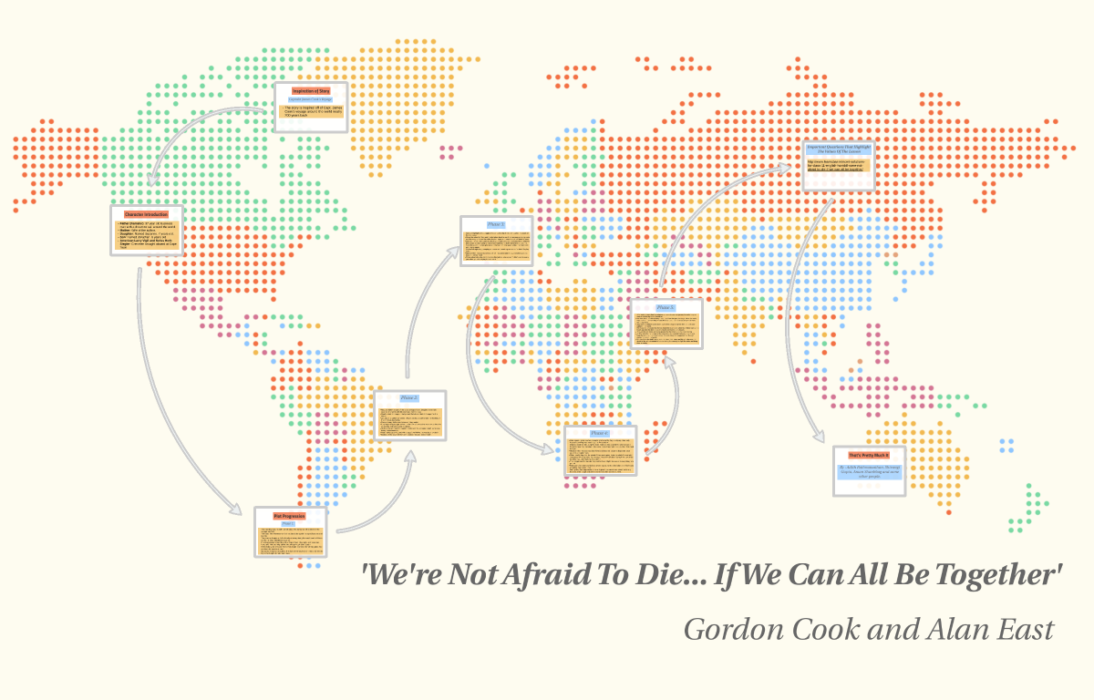
THANK YOU

